Slide 1

DATA ANALYTICS
PHASE 4:DEVELOPMENT PHASE2

Slide 2
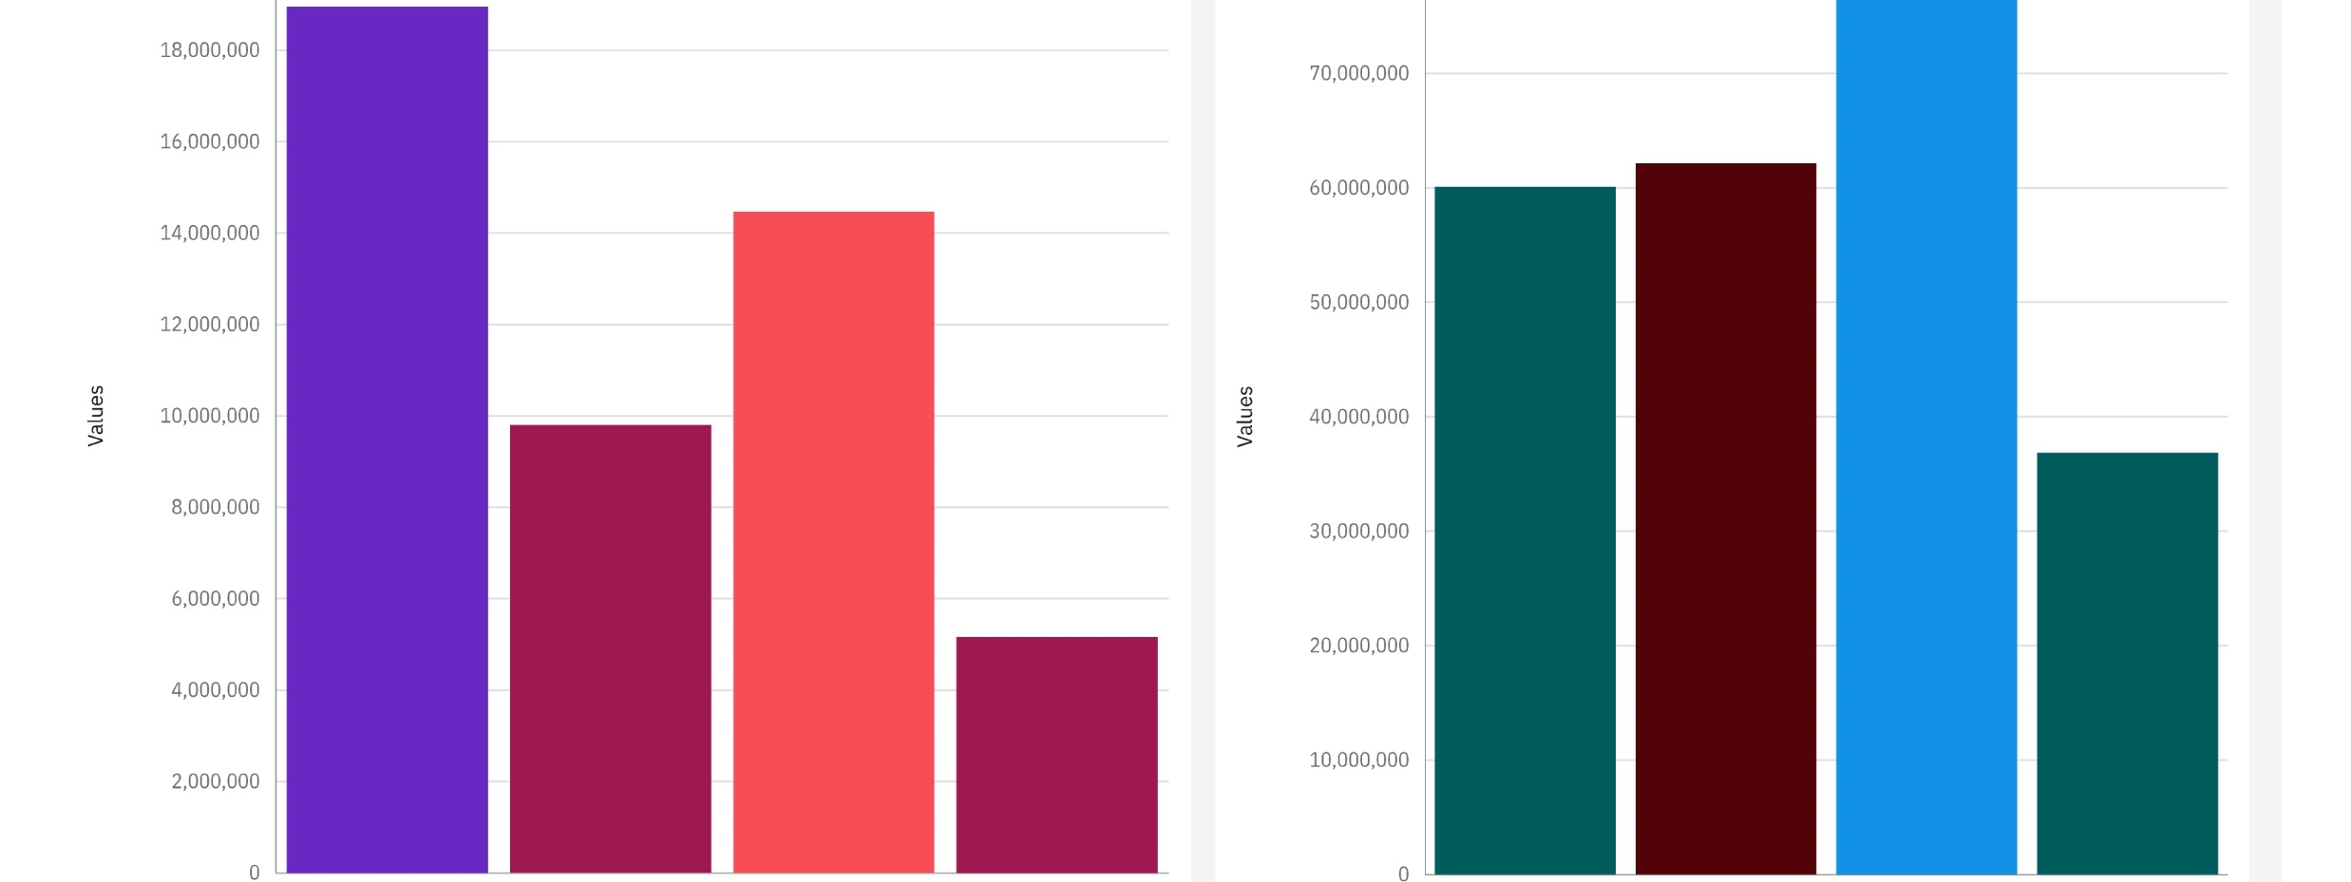
DASHBOARD 1
Dashboard 1 has a 2 bar charts. First chart represents comparison of quantity of 4 products (Q-P1,Q-P2,Q-P3,Q-P4).
2. Second chart represents comparison of revenue of 4 products (S-P1,S-P2,S-P3,S-P4).
3.Here Q-P1 is the top seller among the customers.
4.Whereas sales wise S-P3 tops the chart among the customers.

Slide 3
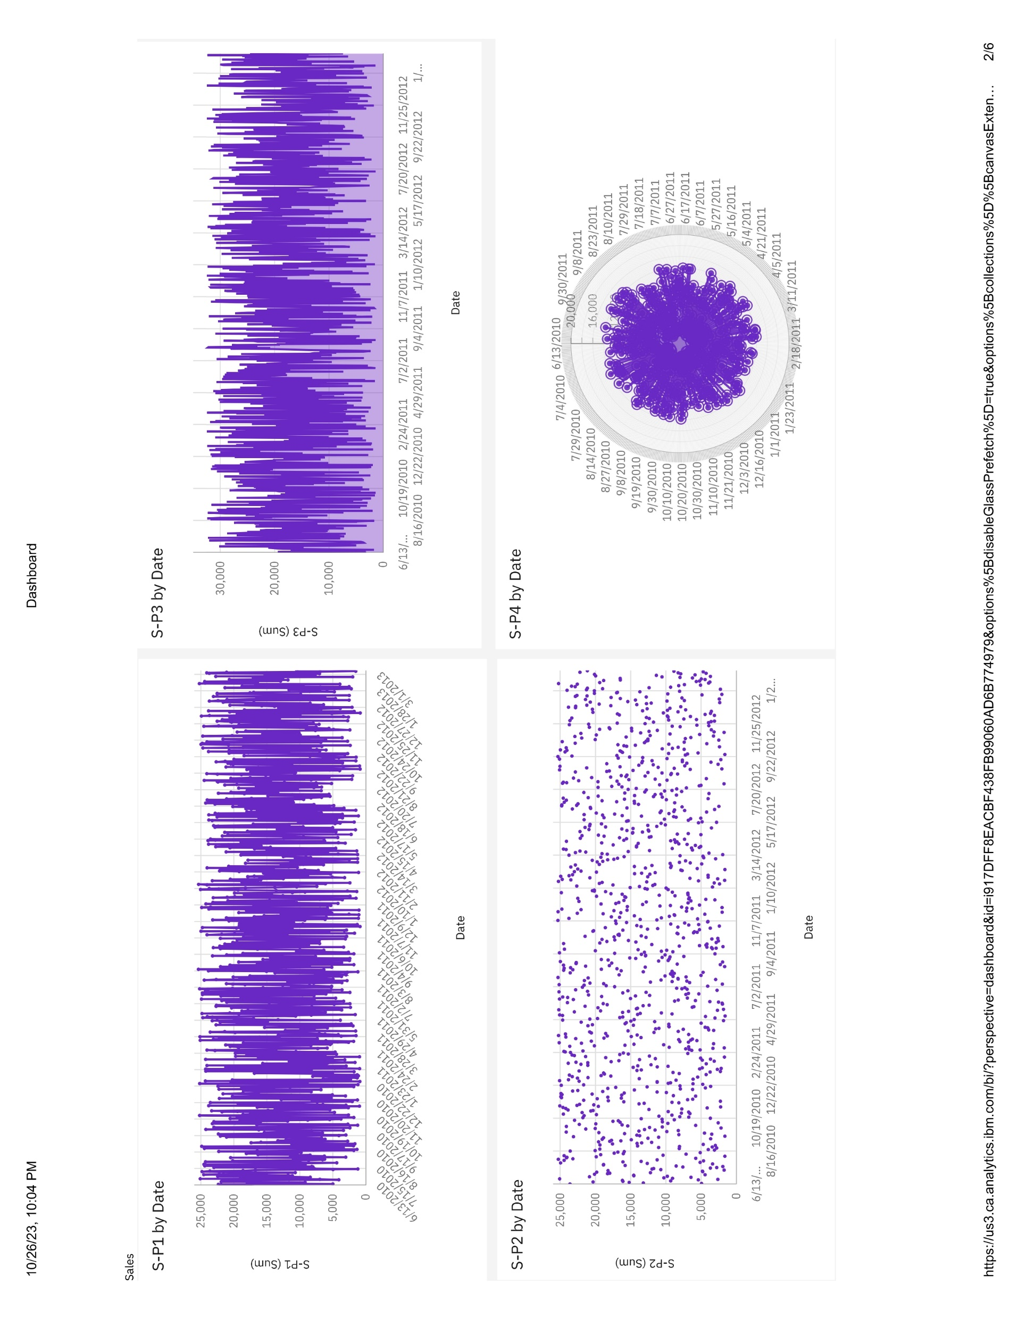
DASHBOARD2
There are four charts representing sales on the individual dates.

Slide 4
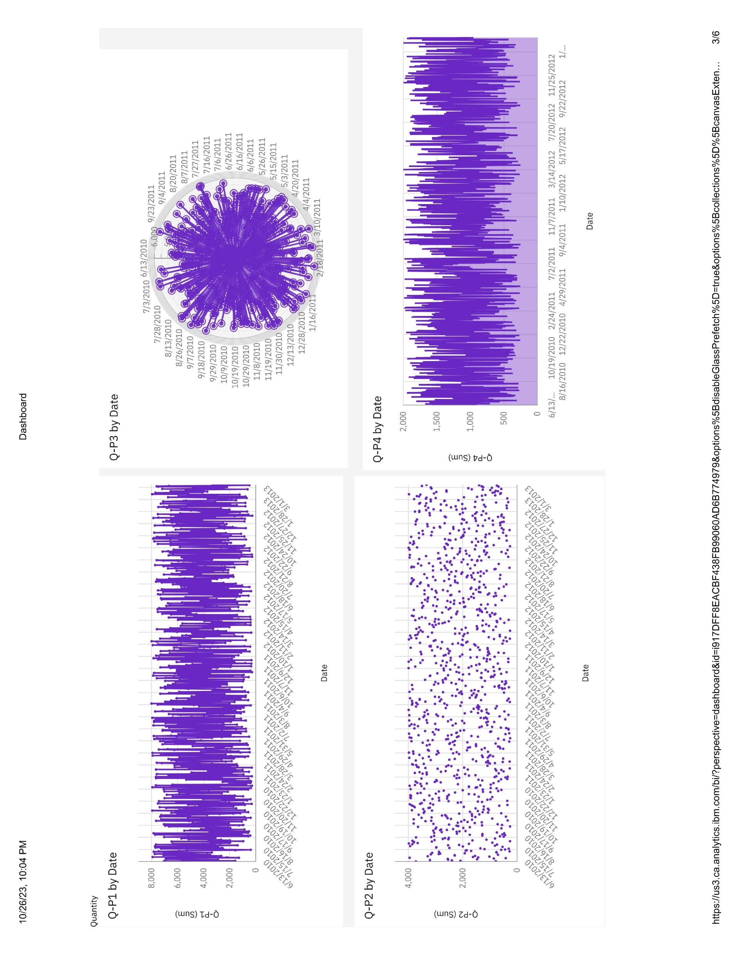
DASHBOARD3
There are four charts representing sales on the individual dates.

Slide 5
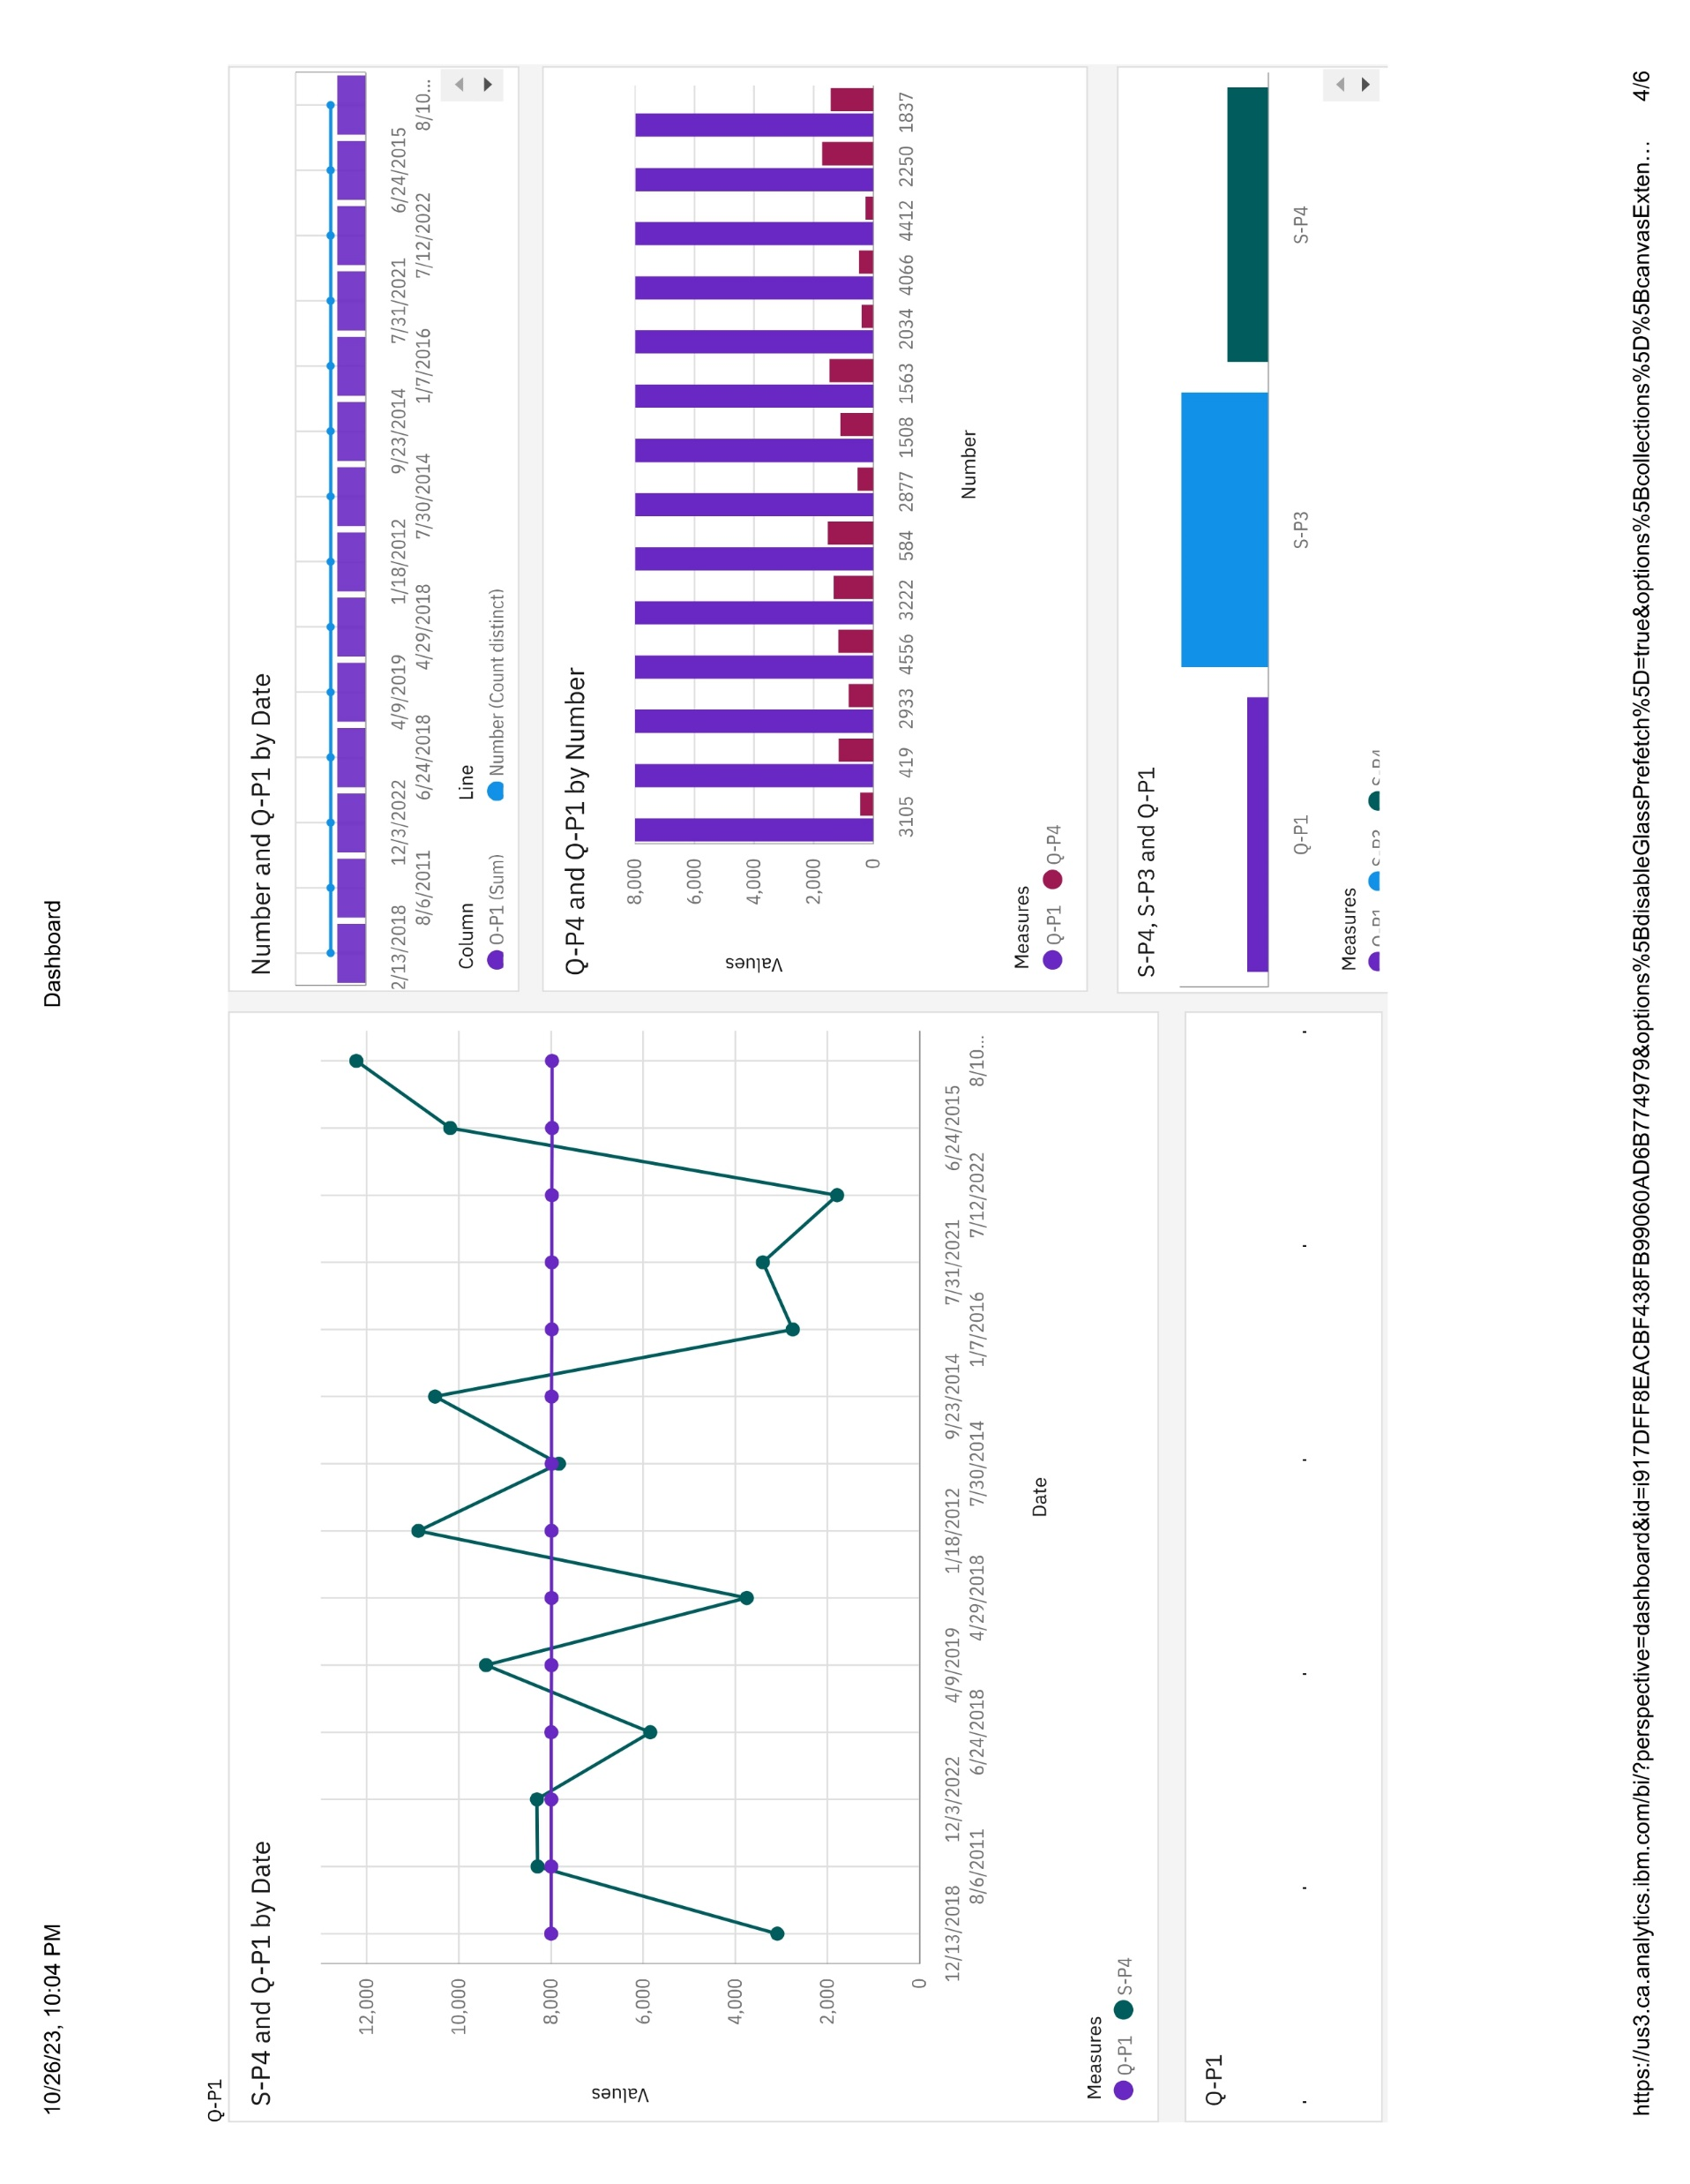
EXAMPLE DASHBOARD

Slide 6
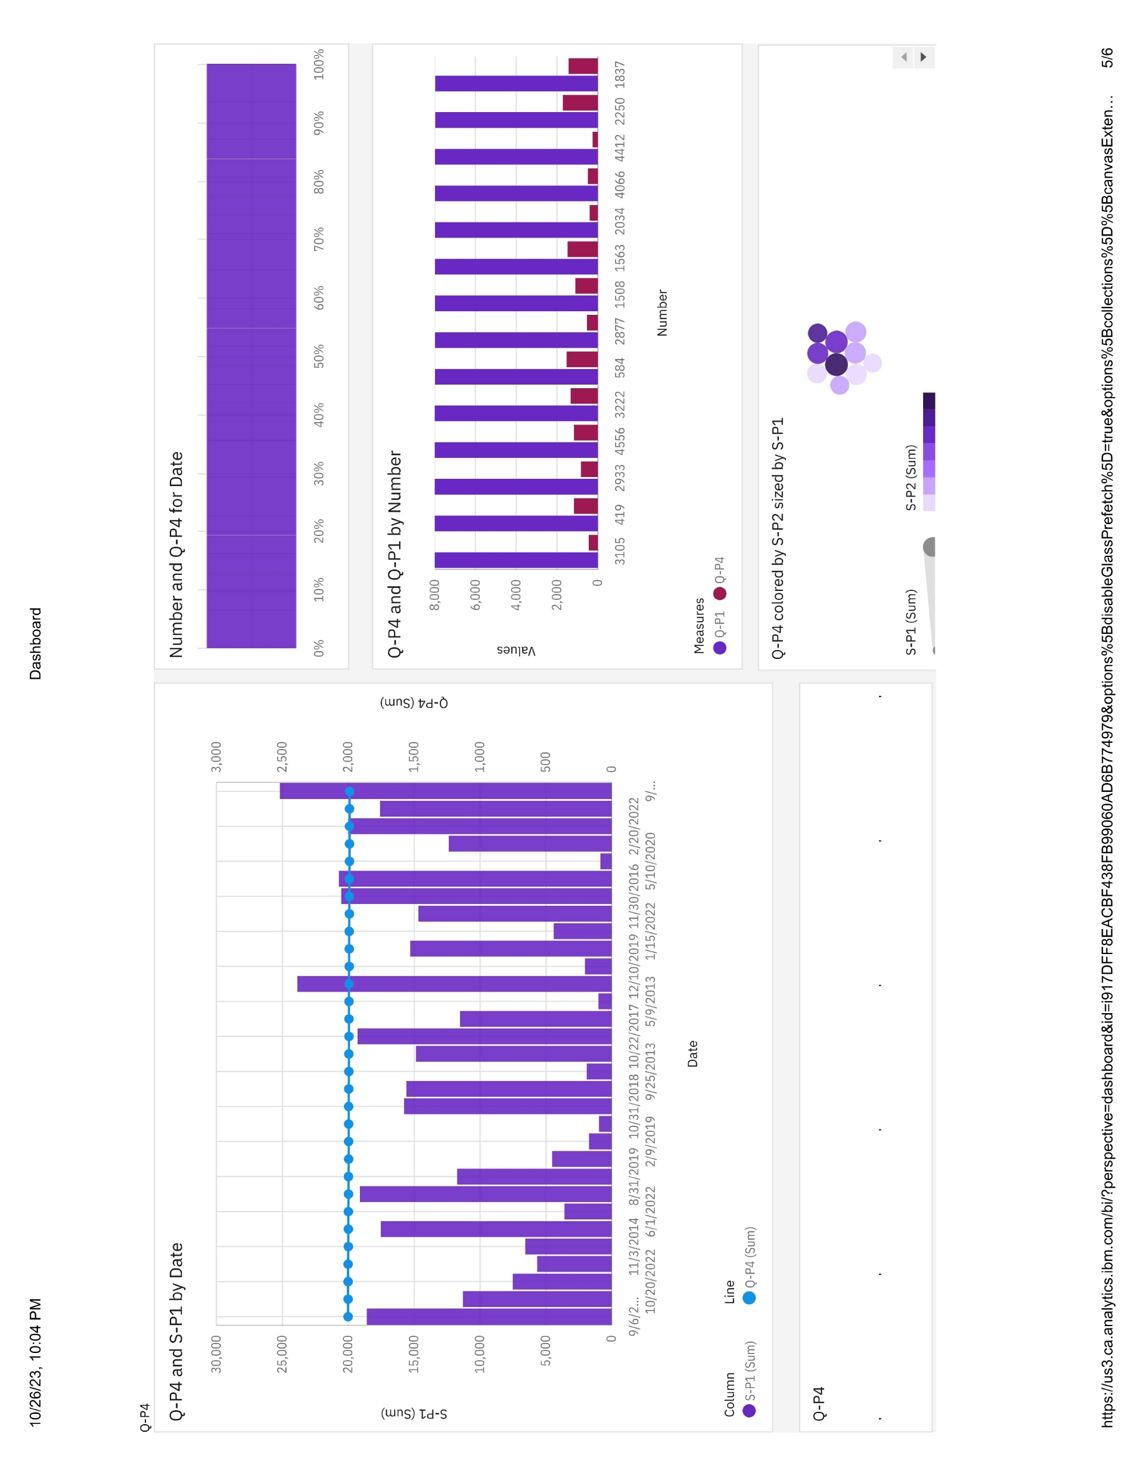
EXAMPLE DASHBOARDS

Slide 7
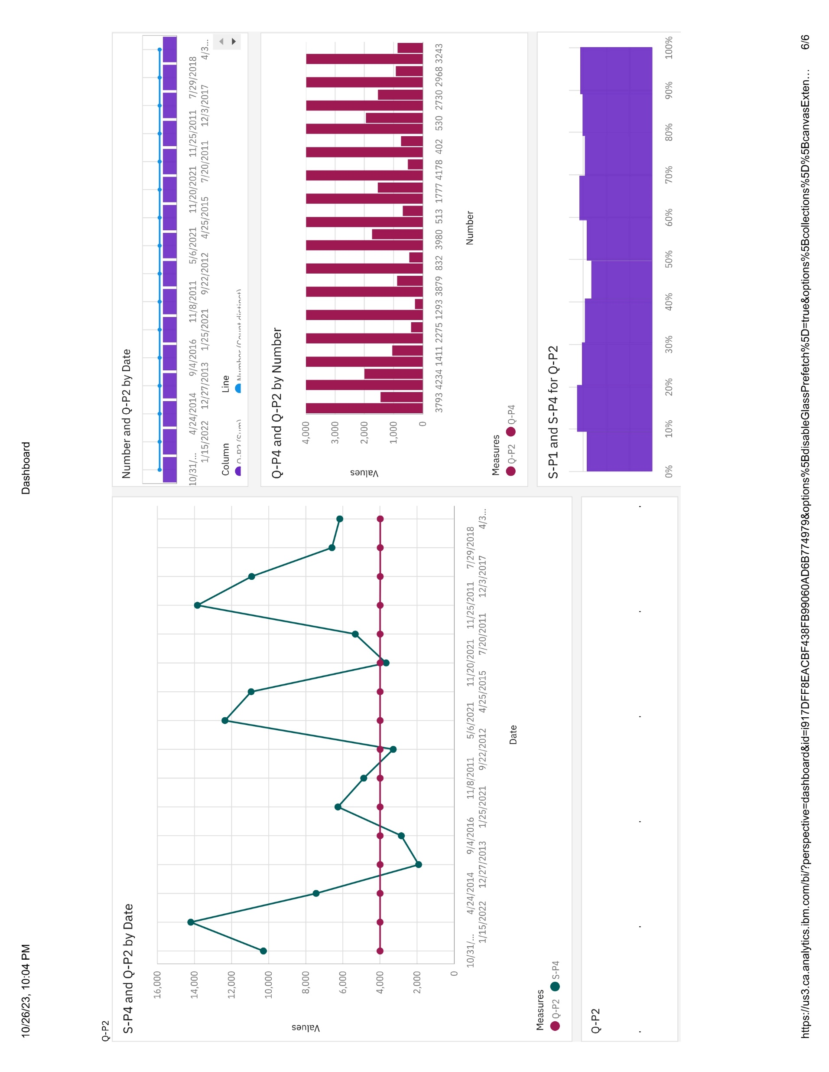
EXAMPLE DASHBOARDS

